Slide 1

NAPAAS ECONOMIC EMPOWERMENT PROGRAM
AGRICULTURAL SCHEME
FOR LEGIONNAIRES

Slide 2
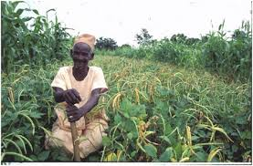
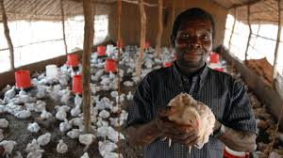
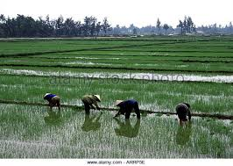
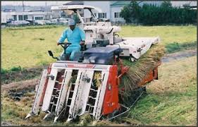
Smallholder Cottage Scheme

Slide 3
According to World Bank
According to World Bank, economic grow from agriculture is two to four time more effective at reducing poverty than growth from any other sector
Developing agribusinesses and investing in smallholder farmers has the potential of transforming agriculture in Africa by creating jobs, increasing incomes, and boosting crop yield and productivity

Slide 4
NAPAAS SCHEME
Basic Needs : Interested beneficiaries access to affordable basic need such as consumable, household equipments, motorcycles, CUG Mobile lines/phone
Health Scheme Setting: Setting up HMO scheme
Housing Scheme: Accessing low-cost housing estate in collaboration with Federal Mortgage Institutions
Agricultural scheme: Implementing the out-growers program with FG Intervention and concession
Transportation Scheme: Accessing transport services
Microfinance : Setting up Microfinance Bank
Education Scheme: Providing educational items (Children)

Slide 5

AGRICUTURAL SCHEME
NAPAAS to provide the platform & framework for legionnaires including family members, to be
engaged & participate
in various agricultural outgrower scheme of both public and private initiatives

Slide 6
Objectives
Agricultural scheme as a tool for self reliance, economic empowerment, Job creation and food security for the legionnaires.
Scheme to provide training and skill acquisition for various types of farming procedure/ technology
Scheme to support agribusinesses through financing (proposed NAPAAS Microfinance Bank), provision of fertilizers, farming Machineries and better quality seedlings

Slide 7
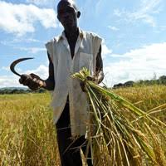
OUTGROWER PROGRAM
Definition: Outgrower program is a program that provided a pre-arranged contract between the smallholder farmers and partner companies to produce specific crops with possible technical and financial support, and a plan for off takers for either local or international markets

Slide 8
MODALITIES
NAPAAS to partner financial institutions, government agencies and various private Agribusiness companies involved in Outgrower program
Initiate and progress plans to involve legionnaires in Outgrower program
Provide guidelines for engagement and support
Coordinate and ensure implementation of program. Objective should be SMART - Specific , Measurable, Actionable , Realistic & Time bound

Slide 9
Types of Outgrower Scheme
Contract Farming: The partner company
1) links farmers to a secure market
2) pays a fair market price for their produce
3) may supply input on credit or provide assistance with micro financing, extension services, training . Transport and packaging
Capacity Building and Training
1) Typically donor–funded
2) Invest exclusively on farmer themselves through skill building, technology transfer through workshops or set up and run demonstration plots
Commodity Aggregation: The company sets a price for a commodity that smallholder farmers can grow and may providing transport to a processing facility

Slide 10
Principles of Success of Scheme
A Market Driven Approach: Assisting the farmer access consistent and reliable market drives economic activities in the rural area, a recipe for sustainability
Input Support: Providing appropriate agricultural input on credit /finance often overcome high initial cost layout
Farmer Selection: Selecting suitable farmers to participate can be crucial to Success of Scheme
Farmer Training: Training in farming practice, business skills, social issues and other area
Commercial and financial viability: both commercial partner and farmer need to make profit
Management Tools: Close monitoring is essential

Slide 11
Participants in Demonstration Plots – Rice Farm

Slide 12
RECOMMENDATIONS
TO NIGERIA LEGION
To provide cultivatable /arable land area for scheme
Access to irrigation- constant water source all year round OR availability of irrigation plan
Land Ownership- Land may be owned by partner company, Individual legionnaires or Nigeria Legion, sometime with possible transfer of ownership opportunity to the farmer after some stipulated period/ buy-off plan
Ensure all Land Tenure and community issues are resolved before investment negotiations
To recommend interested farmers or youths who are ready to farm, not forces to be engaged

Slide 13
RECOMMENDATION TO NAPAAS
NAPAAS to ensure grants and financial supports are made available to the trained farmers to help deploy their new trade e.g. Startup Capital, fertilizer and improved quality seedlings for Capacity building outgrower program type
NAPAAS to ensure scheme included some processing equipment for adding value to farm produce and engage other legionnaires in supply chain dynamics e.g. Rice Mill, Maize Mill etc
Microfinance Bank: The proposed NAPAAS WOTICOM MFB is very essential to effectively carry out this scheme. However, may utilize grants and funds for now with a planned repayment structure

Slide 14
Some Current Available Outgrower Scheme In Nigeria
Dangote Rice Outgrower Scheme in Sokoto
FADAMA Rice Production Program Using Sawa Eco Technology from Japan –pilot scheme ongoing in five states of the federation
Olam Outgrower scheme for cocoa, cashew, sesames seed production
Cottage Industry Agricultural Training and Empowerment Scheme
AgDevCo Smallholder Outgrower Scheme

Slide 15
Donor Agencies to Approach
The MasterCard Foundation: is a private foundation that works with visionary organizations to provide greater access to education, skill training and financial to people living in poverty primarily in Africa.
Ukaid: The Department of International Development (DFID)leads the UK’s work to end extreme poverty.
AgDevCo: is a social impact investor and agribusiness project developer operating exclusively in agriculture in Africa

