Slide 1

NAPAAS
HOUSING
SCHEME
FOR LEGIONNAIRES

Slide 2
NAPAAS SCHEME
Basic Needs : Interested beneficiaries access to affordable basic need such as consumable, household equipments, motorcycles, CUG Mobile lines/phone
Health Scheme Setting: Setting up HMO scheme
Housing Scheme: Accessing low-cost housing estate in collaboration with Federal Mortgage Institutions
Agricultural scheme: Implementing the out-growers program with FG Intervention and concession
Transportation Scheme: Accessing transport services
Microfinance : Setting up Microfinance Bank
Education Scheme: Providing educational items (Children)

Slide 3
HOUSING SCHEME
Napaas will collaborate with Federal Mortgage Institutions and Real Estate Developers to structure a low cost housing estate scheme for Interested beneficiaries
This scheme will involve building 50 or 100 units of 2 bedroom and 3 bedroom bungalows in a closed estate setting in all 19 Northern States
Interested Beneficiaries can access the low-cost housing estate upon meeting the requirements

Slide 4
Scope of Estate Facilities/ Layout
2 & 3 bedroom bungalows (50 or 100 units)
Basic road network – Main roads and layout
Electrification / Street light
Portable Water
Drainage system
Individual Sewerage/Septic Tanks
Electrical Metering System Installed
Perimeter fencing
Parking lot
Security post
Playground
Community Center

Slide 5
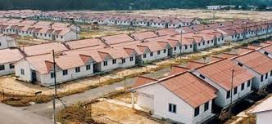
LOW COST HOUSING SHEME

Slide 6
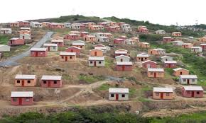
Not So Organized Housing Scheme

Slide 7
NAPAAS Management Team
Responsible for the following actions:
• Coordinate goals and efforts,
• Seek funding opportunities,
• Establish supply and demand for housing (Number of interested beneficiary),
• Identify target areas for housing development, and
• Search for best deal from Developers
• Maximize utilization of resources/Quality

Slide 8
Financial Implication- Tentative
3 Bed room Bungalow to cost N5 Million
2 Bed room to Cost N4.3 Million
Initial Down Payment/ Deposit (10% of Cost) – to be discussed
Monthly repayment value (to be determined)
Tenor – 5 years
Insurance coverage
Security

Slide 9
Obligations to Estate Developer
Information required;
Contract Agreement
Estate Deliverables
Another option may be to have the Developers to build all 100 units and split ownership 50:50 with NAPAAS/ Nigeria Legion

Slide 10
Requirements from Nigeria Legion
To provide Developable Residential Land Area
120,000 square meters in each of the 19 Northern state) – Size not confirmed
List of Interested beneficiaries

Slide 11
Requirements from beneficiaries
Analyze income and ability levels of beneficiary (low, moderate, and middle-income pensioners ).
Eligibility Criteria
Fill Housing Scheme Contract form
ISPO Issued from their bank
Initial down payment/deposit (10% of cost)

Slide 12
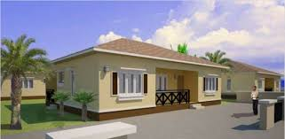
3 Bedroom Bungalow

Slide 13
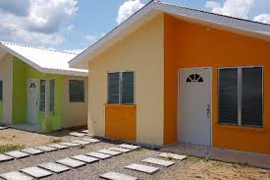
2 Bedroom Bungalow

Slide 14
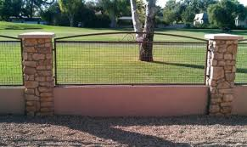
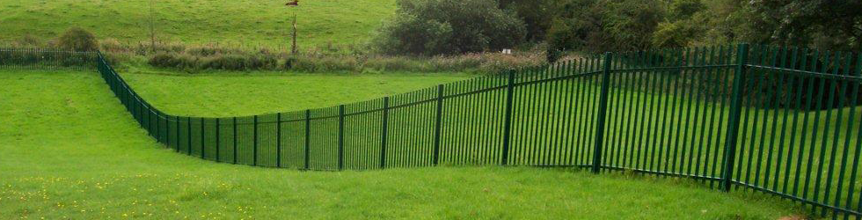
Perimeter Fencing

Slide 15

Appreciation

