Slide 1

ECONOMIC EMPOWERMENT THROUGH PUBLIC PRIVATE PARTNERSHIP INITIATIVES FOR INTERSTED
EX-SERVICEMEN, EX-PARAMILITARY AND ORGANISED PENSION GROUPS FOR SELF SUSTENANCE AND RELIANCE
NATIONAL PERSONAL
ASSET
ACQUISITION SCHEME
(NAPAAS)

Slide 2
INTRODUCTION OF NAPAAS
Brief History:
The NAPAAS Scheme is an initiative born out of the need to appreciate and cater for the welfare of our ex-servicemen, who have served this nation meritoriously, sometimes making the ultimate sacrifice for the peace and unity of our nation, keeping its territorial integrity
The scheme has been extended to include other organized pension bodies like the ex-paramilitary, corporative societies etc.

Slide 3
Objectives
Vision
To support the Ex-servicemen, Ex-paramilitary and pensioners in achieving sustainable standard of living, and alleviating poverty through various intervention, programs and other schemes
Mission
To empower interested pensioners with basic needs items at affordable, structured, discounted and flexible repayment plan

Slide 4
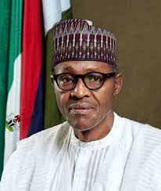

Endorsements
Presidential Endorsement: The President of the Federal Republic of Nigeria, Muhammadu Buhari GCFR endorsed the PAAS scheme on the occasion of launch of the 2017 Armed Forces Remembrance
Day Emblem and appeal fund, November 15th, 2016
Ministerial Endorsement: “In order to ease the hardship of veterans, I recently approved the collaboration between the Nigerian Legion and a corporate organization Personal Asset Acquisition Scheme. This would afford them opportunity to accessing person loans and other scheme under flexible repayment condition. The scheme would also engage with legion in the establishment of Microfinance Bank”. Press briefing by the Honourable Minister of Defence, Mansur Muhammed Dan-Ali on the 2017. Armed Forces Day Celebration on the 1st of November, 2016.
The Minister of Defense has given support for this program
Nigeria Legion Endorsement: The main body
of the legionnaires have also expressed full support for scheme

Slide 5
Scope of NAPAAS Scheme
Basic Needs Items (PAAS) : Interested beneficiaries access to affordable basic need such as consumables, household equipments, motorcycles,
Telecommunication : CUG Mobile lines/phones
Health Scheme : Setting up HMO scheme
Housing Scheme: Accessing low-cost housing estate in collaboration with Federal Mortgage Institutions
Agricultural scheme: Implementing the out-growers program with FG Intervention and Partner Companies
Transportation Scheme: Accessing transport services
Microfinance : Setting up Microfinance Bank
Education Scheme: Providing educational items (Children)

Slide 6

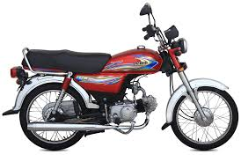





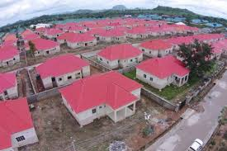
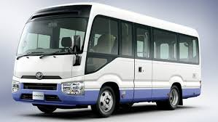
Economic Empowerment-Pictorial

Slide 7
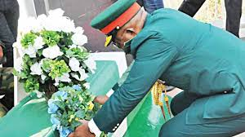





Economic Empowerment Pictorials

Slide 8
Partnership and Funding
Partnership
Phillips Consulting ( Project Consultant)
Technical Partner (9 Mobile) ,
Nigeria Legion , Federal & State Governments
Insurance Company
NGOs, Partner Companies
Funding
Banks (Unity Bank, Fidelity Bank , First Bank)
Companies (Corporate Social Responsibility )
Donor Agencies, Foundations - Grants /Gifts
Private Lenders/Investors

Slide 9
Phillips Consulting - Role
Program Managers
To monitor & evaluate NAPAAS team activities- project coordination and implementation
Provide guidance as its consistent with best practices, government regulations and standards
Organize and host forum for targeted stakeholders /investors
Help secure donor and grant schemes for ex-servicemen
Authenticate scheme with corporate international presence and involvement

Slide 10
Project Status/ Update
All necessary documentation and approval obtained including Presidential and Ministerial endorsements
Banks alignment and involvement secured
Suppliers/Investors engaged and ready to deliver basic need items, some already made commitment payment
Insurance Company engaged –Standard Alliance Ltd.
Funding for proposed Microfinance Bank secured
BG offer obtained/ Instrument been processed
Other Financial Investors have been engaged
Book launch on Economic Empowerment initiative for Ex-servicemen been developed
National Launch/flag-off slated for March 15/16, 2018 in Jos, Plateau State

Slide 11


1. Personal Asset Acquisition Scheme (PAAS) – For Basic Items
The interested legionnaires can acquire basic items at affordable prices with a structure flexible repayment plan upon meeting the requirements
These items include but not limited to:
Consumables like Rice, Groundnut Oil, Tin Tomatoes, Garri
Household equipment like Television, Fridge, Generator Set
Motorcycle, Tricycle (Keke)
Laptop

Slide 12
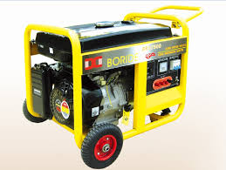



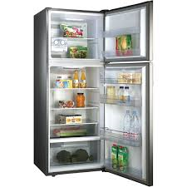


Basic Needs Item (PAAS)

Slide 13
Transaction Dynamics
Payment of a Mandatory non refundable security deposit/participatory fee of N10,000
Life Insurance of Beneficiaries & Comprehensive insurance of non consumable items
In-built Cost of items to include: Transportation, Handling Charges, Warehousing, Road Settlements, Admin Charges, Bank Charges
Consultancy Services , Commissions and facilitating payments

Slide 14
Contractors Obligation
Purchase of registration form (non refundable fee)
Provision of necessary registration documents
Acknowledgement of Award letter and Management
Letter of Acceptance of award/contract
Pro forma Invoice and delivery note of supply
Supply schedule

Slide 15
Requirement from Beneficiaries
Interested Beneficiaries to obtain and complete application form
Sign and issue ISPO in favor of supplier
Pay Non refundable mandatory contributory security deposit of N10,000
Sign Life Insurance documents
Provide all relevant documents like I.D Card etc

Slide 16

NAPAAS
HOUSING
SCHEME
FOR LEGIONNAIRES

Slide 17
2. HOUSING SCHEME
Napaas will collaborate with Federal Mortgage Institutions and Real Estate Developers to structure a low cost housing estate scheme for Interested beneficiaries
This scheme will involve building 50 or 100 units of 2 bedroom and 3 bedroom bungalows in a closed estate setting in all 19 Northern States
Interested Beneficiaries can access the low-cost housing estate upon meeting the requirements

Slide 18
Scope of Estate Facilities/ Layout
2 & 3 bedroom bungalows (50 or 100 units)
Basic road network – Main roads and layout
Electrification / Street light
Portable Water
Drainage system
Individual Sewerage/Septic Tanks
Electrical Metering System Installed
Perimeter fencing
Parking lot
Security post
Playground
Community Center

Slide 19
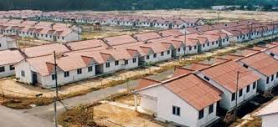
LOW COST HOUSING SHEME

Slide 20
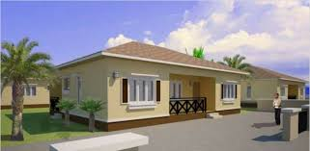
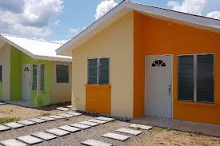
2 & 3 Bedroom Bungalows

Slide 21
TRANSACTION DYNAMICS
3 Bed room Bungalow to cost N5 Million
2 Bed room to Cost N4.3 Million
Initial Down Payment/ Deposit (10% of Cost) – to be discussed
Monthly repayment value (to be determined)
Tenor – 5 years
Insurance coverage
Security

Slide 22
NAPAAS Management Team
Responsible for the following actions:
• Coordinate goals and efforts,
• Seek funding opportunities,
• Establish supply and demand for housing (Number of interested beneficiary),
• Secure Large Residential Land Area from Nigeria Legion
• Search for best deal from Developers
• Maximize utilization of resources/Quality

Slide 23
Requirements from beneficiaries
Analyze income and ability levels of beneficiary (low, moderate, and middle-income pensioners ).
Eligibility Criteria
Fill Housing Scheme Contract form
ISPO Issued from their bank
Initial down payment/deposit (10% of cost)

Slide 24

NAPAAS ECONOMIC EMPOWERMENT PROGRAM
AGRICULTURAL SCHEME
FOR LEGIONNAIRES

Slide 25

3. AGRICUTURAL SCHEME
NAPAAS to provide the platform & framework for legionnaires including family members, to be
engaged & participate
in various agricultural outgrower scheme of both public and private initiatives

Slide 26
Objectives
Agricultural scheme as a tool for self reliance, economic empowerment, Job creation and food security for the legionnaires.
Scheme to provide training and skill acquisition for various types of farming procedure/ technology
Scheme to support agribusinesses through financing (proposed NAPAAS Microfinance Bank), provision of fertilizers, farming Machineries and better quality seedlings

Slide 27

OUTGROWER PROGRAM
Definition: Outgrower program is a program that provided a pre-arranged contract between the smallholder farmers and partner companies to produce specific crops with possible technical and financial support, and a plan for off takers for either local or international markets

Slide 28
MODALITIES
NAPAAS to partner financial institutions, government agencies and various private Agribusiness companies involved in Outgrower program
Initiate and progress plans to involve legionnaires in Outgrower program
Provide guidelines for engagement and support
Coordinate and ensure implementation of program. Objective should be SMART - Specific , Measurable, Actionable , Realistic & Time bound

Slide 29
Types of Outgrower Scheme
Contract Farming: The partner company
1) links farmers to a secure market
2) pays a fair market price for their produce
3) may supply input on credit or provide assistance with micro financing, extension services, training . Transport and packaging
Capacity Building and Training
1) Typically donor–funded
2) Invest exclusively on farmer themselves through skill building, technology transfer through workshops or set up and run demonstration plots
Commodity Aggregation: The company sets a price for a commodity that smallholder farmers can grow and may providing transport to a processing facility

Slide 30
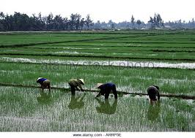
Participants in Demonstration Plots – Rice Farm

Slide 31
RECOMMENDATIONS
TO NIGERIA LEGION
To provide cultivatable /arable land area for scheme
Access to irrigation- constant water source all year round OR availability of irrigation plan
Land Ownership- Land may be owned by partner company, Individual legionnaires or Nigeria Legion, sometime with possible transfer of ownership opportunity to the farmer after some stipulated period/ buy-off plan
Ensure all Land Tenure and community issues are resolved before investment negotiations
To recommend interested farmers or youths who are ready to farm, not forces to be engaged

Slide 32
RECOMMENDATION TO NAPAAS
NAPAAS to ensure grants and financial supports are made available to the trained farmers to help deploy their new trade e.g. Startup Capital, fertilizer and improved quality seedlings for Capacity building outgrower program type
NAPAAS to ensure scheme included some processing equipment for adding value to farm produce and engage other legionnaires in supply chain dynamics e.g. Rice Mill, Maize Mill etc
Microfinance Bank: The proposed NAPAAS WOTICOM MFB is very essential to effectively carry out this scheme. However, may utilize grants and funds for now with a planned repayment structure

Slide 33
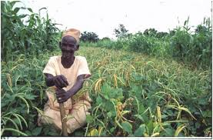


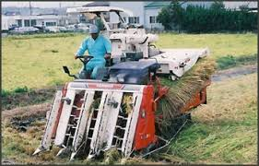
Smallholder Cottage Scheme

Slide 34
Some Current Available Outgrower Scheme In Nigeria
Dangote Rice Outgrower Scheme in Sokoto
FADAMA Rice Production Program Using Sawa Eco Technology from Japan –pilot scheme ongoing in five states of the federation
Olam Outgrower scheme for cocoa, cashew, sesames seed production
Cottage Industry Agricultural Training and Empowerment Scheme
AgDevCo Smallholder Outgrower Scheme

Slide 35

NAPAAS
EDUCATIONAL SCHEME
For Children of the Legionnaires

Slide 36
4. EDUCATIONAL SCHEME
Objectives:
To seek and provide opportunities for scholarship for children of the legionnaire
To provide grants, tuition fees through Donor Agencies, NGO, School Scholarship Board etc
To provide study aids to students in terms of educational Materials, Laptops, internet access etc

Slide 37
NAPAAS RESPONSIBILITIES
To create awareness for the need to help and support the children and dependants of our ex-servicemen through education
To engage donor agencies, Foundations, CSR
To seek and maintain scholarship Funds
To structure and manage scholarship program
To organize Fund Raiser events
To publicize the existence of such scholarship opportunities to beneficiaries and family
Keeping records and statistical analysis of success of program

Slide 38

SCHOLARSHIP SCHEME
Eligibility Criteria: Applicants must be children or dependants of the legionnaires
Type of Scholarship Program:
Full Time / Part Time Scholarship
Study Aid Scholarship-Educational Items, laptops, Technological support
Grants and Donations- Regular or One-off
Sponsorship Category: Primary, Secondary and Tertiary Education

Slide 39

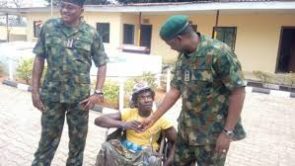
Preference for their Children
Our Fallen Heroes
Incapacitated Ex-servicemen

Slide 40
Application Procedure
Interested eligible applicants shall complete the scholarship form either an on-line or at NAPAAS office
Applicants to pay processing fee (if any)
Provide detailed supporting documents indicating relationship with the legionnaire
NAPAAS shall contact applicant after preliminary review of their documentation
Applicants to undergo qualification processes (if any)

Slide 41
Selection Process (options)
An All-comers affair based on type of grant
Selection by Merit through Educational Qualification
Selection by Winning an organized Quiz Competition
Selection based on Special Criteria e.g. children of our fallen heroes/ injured veterans
Selection based on educational discrimination e.g. the girl child

Slide 42

NAPAAS Educational Schme: Securing his Future

Slide 43
Relevant Agencies, Bodies and Organizations
UNICEF
COMPANIES’ CSR
WORLD BANK
MASTERCARD FOUNDATION
BILL GATES FOUNDATION
NATIONAL SCHOLARSHIP BOARD

Slide 44

9 MOBILE CUG PACKAGE
FOR THE LEGIONNAIRES

Slide 45
5. 9 MOBILE CUG PACKAGE
9 Mobile is the third largest communication company in Nigeria that caters for both voice and data telecommunication needs of the Nigeria populace.
9 Mobil has been in business in-country for about 10 years providing satisfactory services, and has earn its position as the preferred network providers among its competitors.
9 Mobile has agreed to partner with NAPAAS to provide CUG lines to the Legionnaires and family with other great benefits to the scheme

Slide 46

Features of the Scheme
The 9 Mobile CUG package enables easy and cost effective means of communication amongst the legionnaires
It provides better means 0f
communication between
the legionnaires and their
family members
It enables the legionnaires
access to NAPAAS welfare
scheme

Slide 47



9 Mobile Total Package Include:
Scholarship scheme
Group Life Insurance (N300,000)
Health Insurance
Access to Loan (KWIKCASH Loan between N5,000 to N100,000
Renovation of Legion Offices
Qualification for a raffle draw to win fantastic prizes

Slide 48
Terms and Conditions
Each Legionnaire to fill a CUG contract form
Each Legionnaire to pay mandatory N1,000 access fee per month for 18 months
Each Legionnaire to purchase a phone for N6,000 payable over a 3 months period (@ N2,000 per month repayment plan)

Slide 49
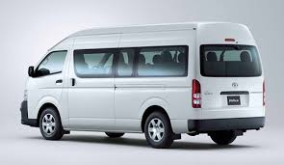
NAPAAS
Transportation
Scheme
To Provide Affordable Road Transportation To the Legionnaires Across The Country

Slide 50
6. TRANSPORTATION SCHEME
As part of its business strategy to sustain the scheme, NAPAAS has introduced a transport scheme by which Nigeria Legion will provide buses to established transportation /logistics companies to operate on its behalf and provide return on investment at a agreed/shared percentage

Slide 51
Objectives of Transport Scheme
As a source of income for Nigeria Legion /NAPAAS , been a business venture
To provide boarding discount or rebate to legionnaires across the nation
To help address the transportation challenges in-country
To help promote the NAPAAS scheme as the busses will be branded

Slide 52
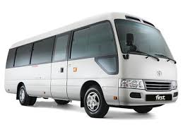
Investment Opportunity/Modalities
Nigeria Legion shall issue contract to selected investors to purchase the buses
The buses shall be given out to qualified transport operators to operate on behalf of NL
Repayment shall be done over a 5 year period at an agreed monthly amount

Slide 53
Eligibility Criteria
The eligibility criteria for Transporter access the scheme shall be one of the following
Membership of Nigeria Labor Congress. Trade Union Congress or other labor unions or affiliates; OR
Membership of Association of Local Government of Nigeria (ALGON): OR
State Government or Associated Road Mass Transit Agencies OR
Private Sector road transit operators

Slide 54
Application and Documentation
Application and Submission procedure (to be provided soon)
Documentation
Each application must be accompanied by;
i) Feasibility Study/Business Plan
ii) Certificate of Incorporation/ Business Registration
iii)Form CAC 2-Statement of Share Capital and Return of Allotment
iv) Form CAC 7- Particulars of Directors
v) Form CAC 2.1 Particulars of Company Secretary
vi) Company Income Tax Certificate and/or Tax Payer Registration Certificate
vii) Memorandum and Articles of Associate of the company (where applicable)
viii) Corporate Profile of the company including experience and track record in mass transit operations
Notes:
i

Slide 55
Application Cont’
ix) Audited Accounts of the company for the last 3 years
x) Bank Statement of the company
xi) Management Account of the company for the year under review
xii) Valid operating permit or license (where applicable)
xiii) Letter of Introduction/membership of the National Union of Road Transport Workers (NURTW) or affiliates (where applicable)
xiv) Current Annual Returns filled at CAC, and
xv) Any other document that may be required by NAPAAS

