Slide 1

NAPAAS
Transportation
Scheme
To Provide Affordable Road Transportation To the Legionnaires Across The Country

Slide 2
TRANSPORTATION SCHEME
As part of its business strategy to sustain the scheme and generate internal revenue, NAPAAS has introduced a transport scheme by which Nigeria Legion will provide buses to established transportation /logistics companies to operate on its behalf and provide return on investment at a agreed/shared percentage

Slide 3
Objectives of Transport Scheme
As a source of income for Nigeria Legion /NAPAAS , been a business venture
To provide boarding discount or rebate to legionnaires across the nation
To help address the transportation challenges in-country
To help promote the NAPAAS scheme as the busses will be branded

Slide 4
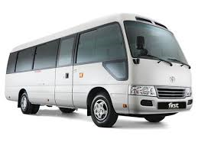
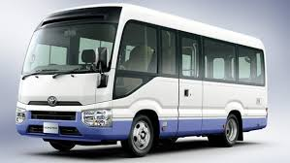
Investment Opportunity/Modalities
Nigeria Legion shall issue contract to selected investors to purchase the buses
The buses shall be given out to qualified transport operators to operate on behalf of NL
Repayment shall be done over a 5 year period at an agreed monthly amount

Slide 5
Eligibility Criteria
The eligibility criteria for Transporter to access the scheme shall be one or a combination of the following
Membership of Nigeria Labor Congress. Trade Union Congress or other labor unions or affiliates; OR
Membership of Association of Local Government of Nigeria (ALGON): OR
State Government or Associated Road Mass Transit Agencies OR
Private Sector road transit operators

Slide 6
Application and Documentation
Application and Submission procedure (to be provided soon)
Documentation
Each application must be accompanied by;
i) Feasibility Study/Business Plan
ii) Certificate of Incorporation/ Business Registration
iii)Form CAC 2-Statement of Share Capital and Return of Allotment
iv) Form CAC 7- Particulars of Directors
v) Form CAC 2.1 Particulars of Company Secretary
vi) Company Income Tax Certificate and/or Tax Payer Registration Certificate
vii) Memorandum and Articles of Associate of the company (where applicable)
viii) Corporate Profile of the company including experience and track record in mass transit operations
Notes:
i

Slide 7
Application Cont’
ix) Audited Accounts of the company for the last 3 years
x) Bank Statement of the company for the last 6 months
xi) Management Account of the company for the year under review
xii) Valid operating permit or license (where applicable)
xiii) Letter of Introduction/membership of the National Union of Road Transport Workers (NURTW) or affiliates (where applicable)
xiv) Current Annual Returns filled at CAC, and
xv) Any other document that may be required by NAPAAS

